Slide 1
Intro to Test Driven Development

Slide 2
Hello!
My name is Sana Javed :) @sanacodes
I’m a software developer at National Journal
Transitioned to the tech field from digital media
I also co-organize Prince George’s Tech Meetup so join us!

Slide 3
What is Testing and Why Does It Matter?
As applications grow and evolve over time, tests are pieces of code that we write to ensure that:
Current features work the way we expect them to
New features don’t break existing features
Software can easily adapt.

Slide 4
Why Should I Write Tests?
Whether it’s the users or the developer, one way or another, someone is testing your code.
Users are bound to encounter bugs but as developers, we can minimize how many they encounter.
Tests provide a safety net so that we can:
Refactor code
Add new features
Avoid reintroducing bugs we already fixed

Slide 5
So What’s Test Driven Development?
Breaking requirements into smaller pieces is a regular thing when writing code.
TDD reinforces that concept and applies it to testing.
When you write the test first, you have to figure out what the requirements for this bit of code are and what it would mean for the test to “pass” or to “fail”.
When paired with tests like this, you naturally keep your functions and methods quite succinct and DRY.

Slide 6
An Example:
Letter Count (Without TDD)

Slide 7
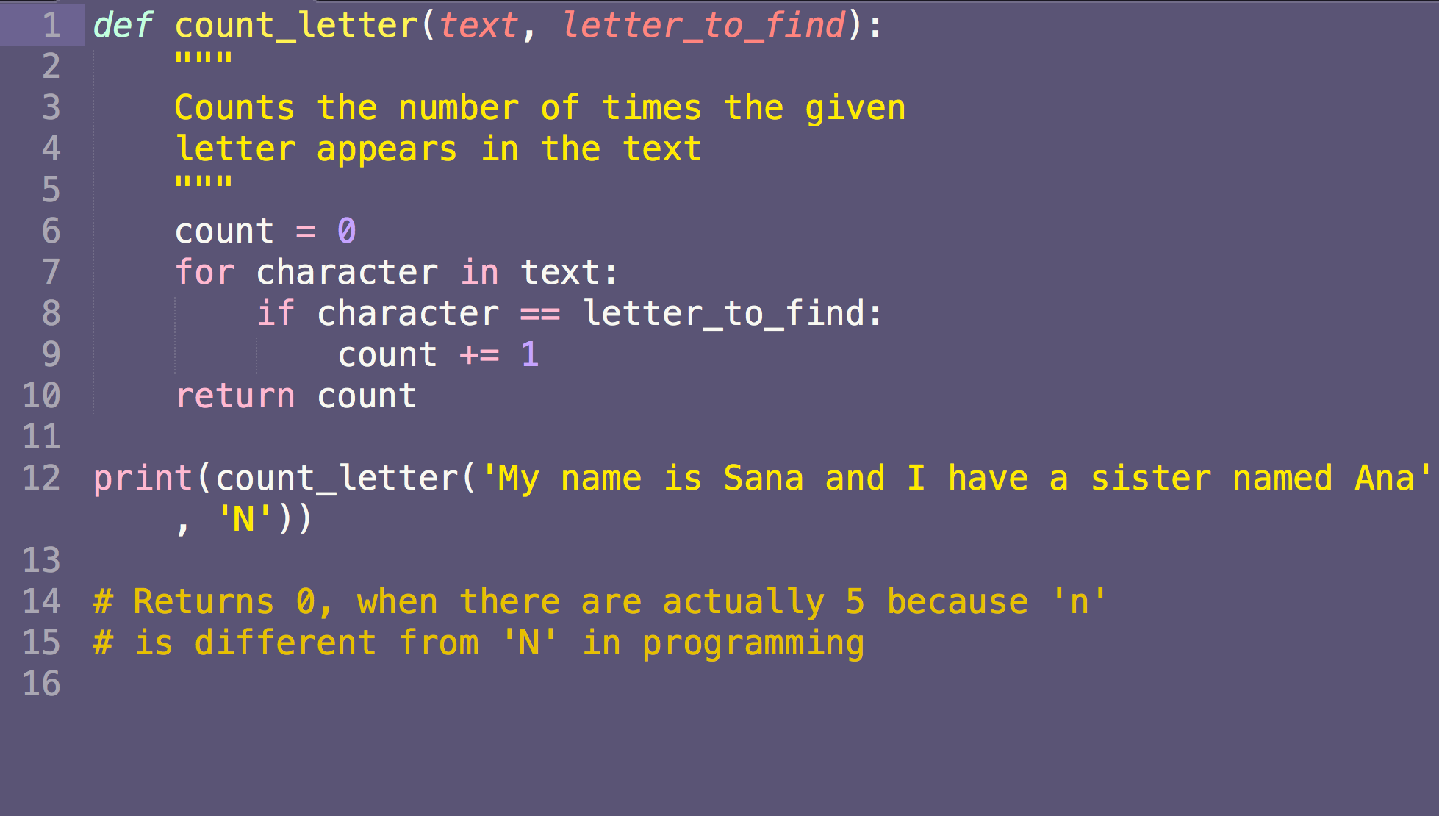

Slide 8
Let’s fix things!

Slide 9
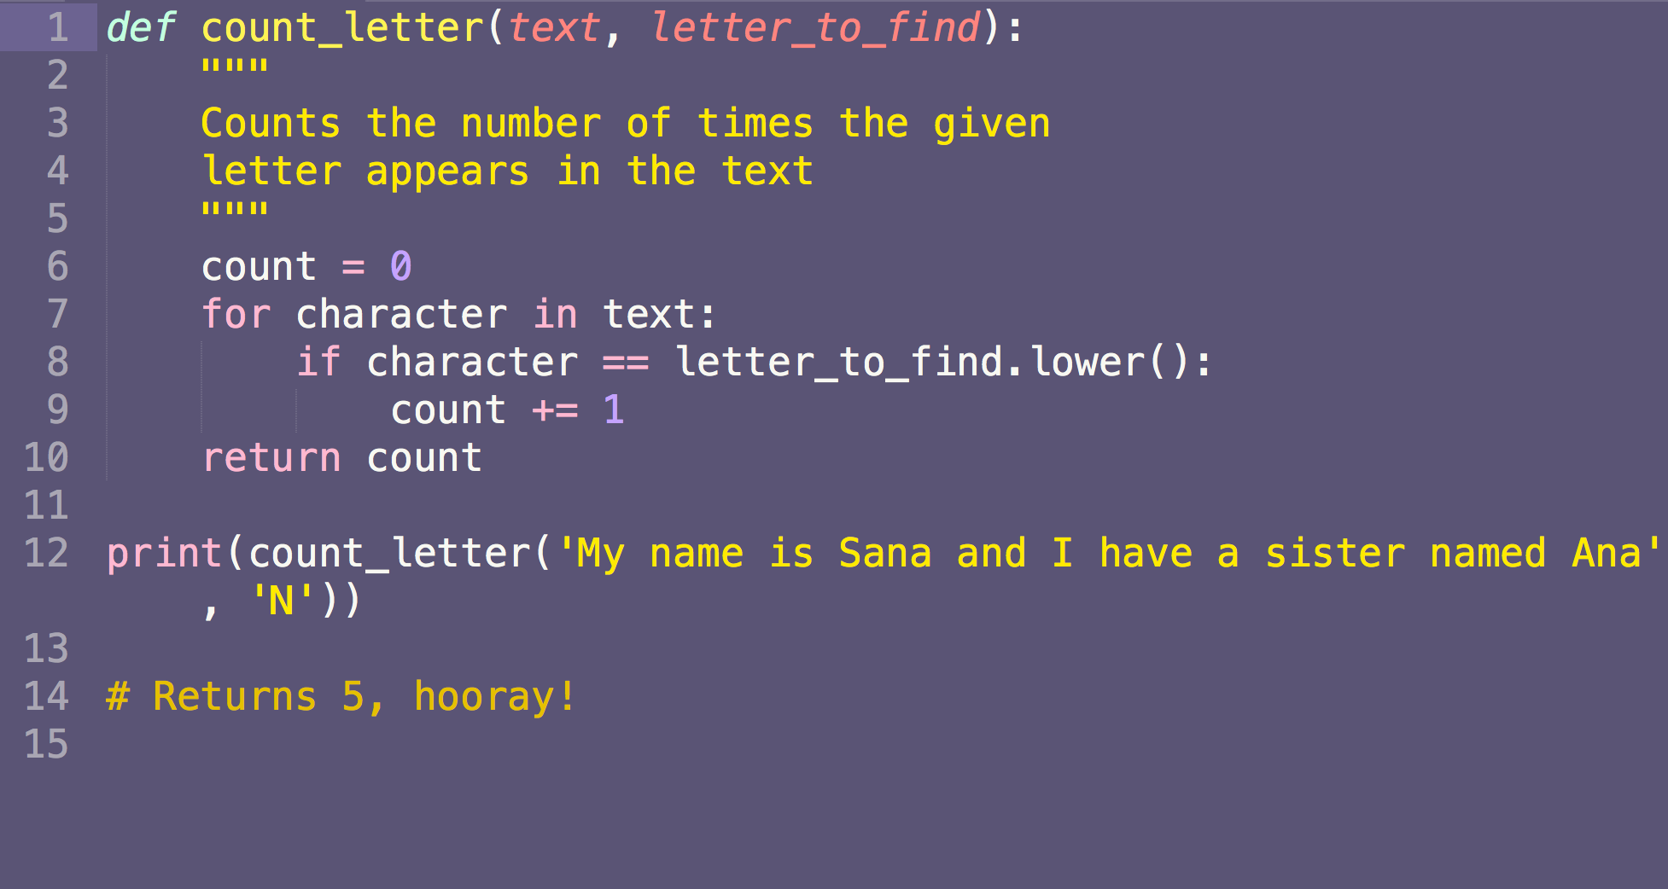

Slide 10
But wait...

Slide 11
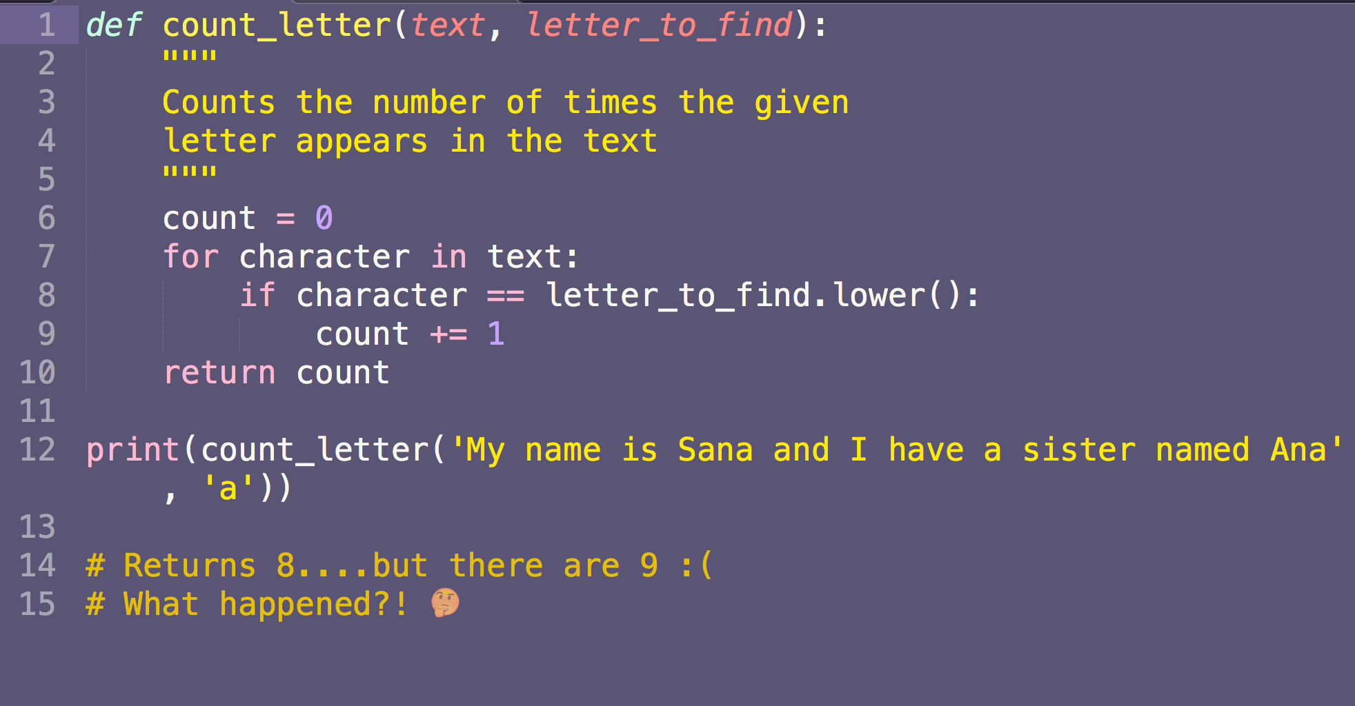

Slide 12
DAMN!
WHAT DO I DO NOW??

Slide 13
100%
How can I be confident that I’ve fixed the bug but not created new ones in the process?

Slide 14
TDD Time!

Slide 15
Yikes a Bug! How Would TDD Apply Here?
Write your test first.
Add the docstring with your requirements for the test.
Run your test (yes, even before you’ve written any code). Ensure it fails.
Fix the code.
Run the test again and ensure it passes.

Slide 16
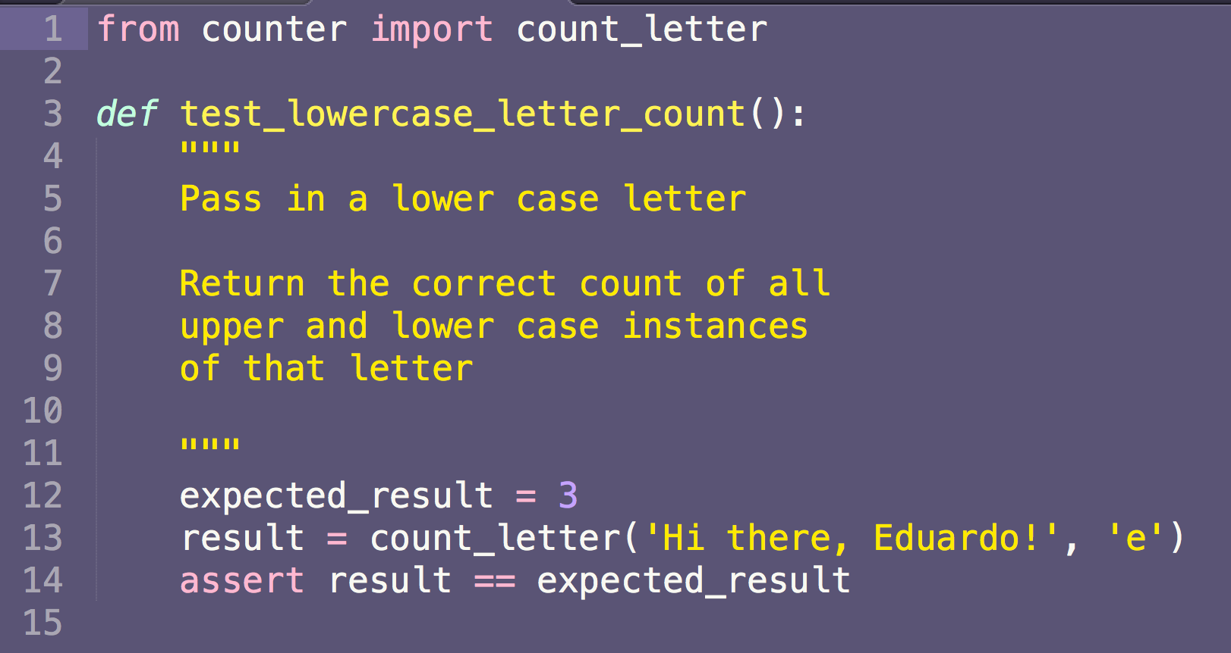
Step 1: Let’s write a test and our requirements!

Slide 17
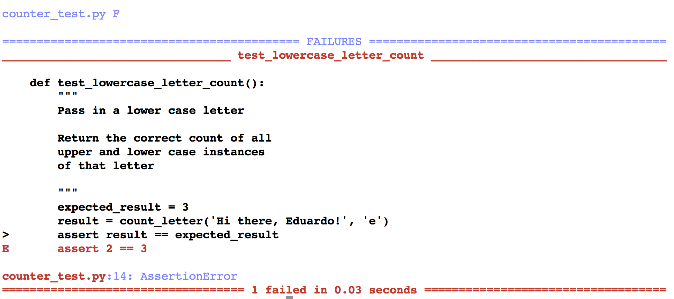
Step 2: Let’s run our test and make sure it fails

Slide 18
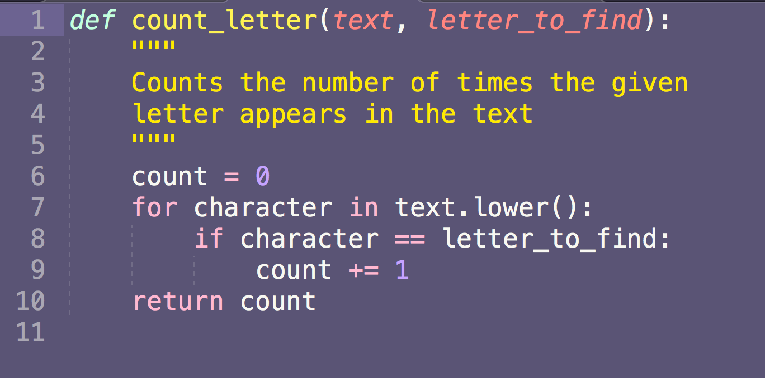
Step 3: Let’s add our solution

Slide 19
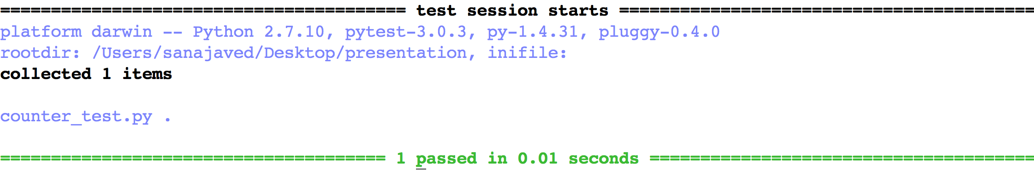
Step 4: Run our test and see if they pass

Slide 20
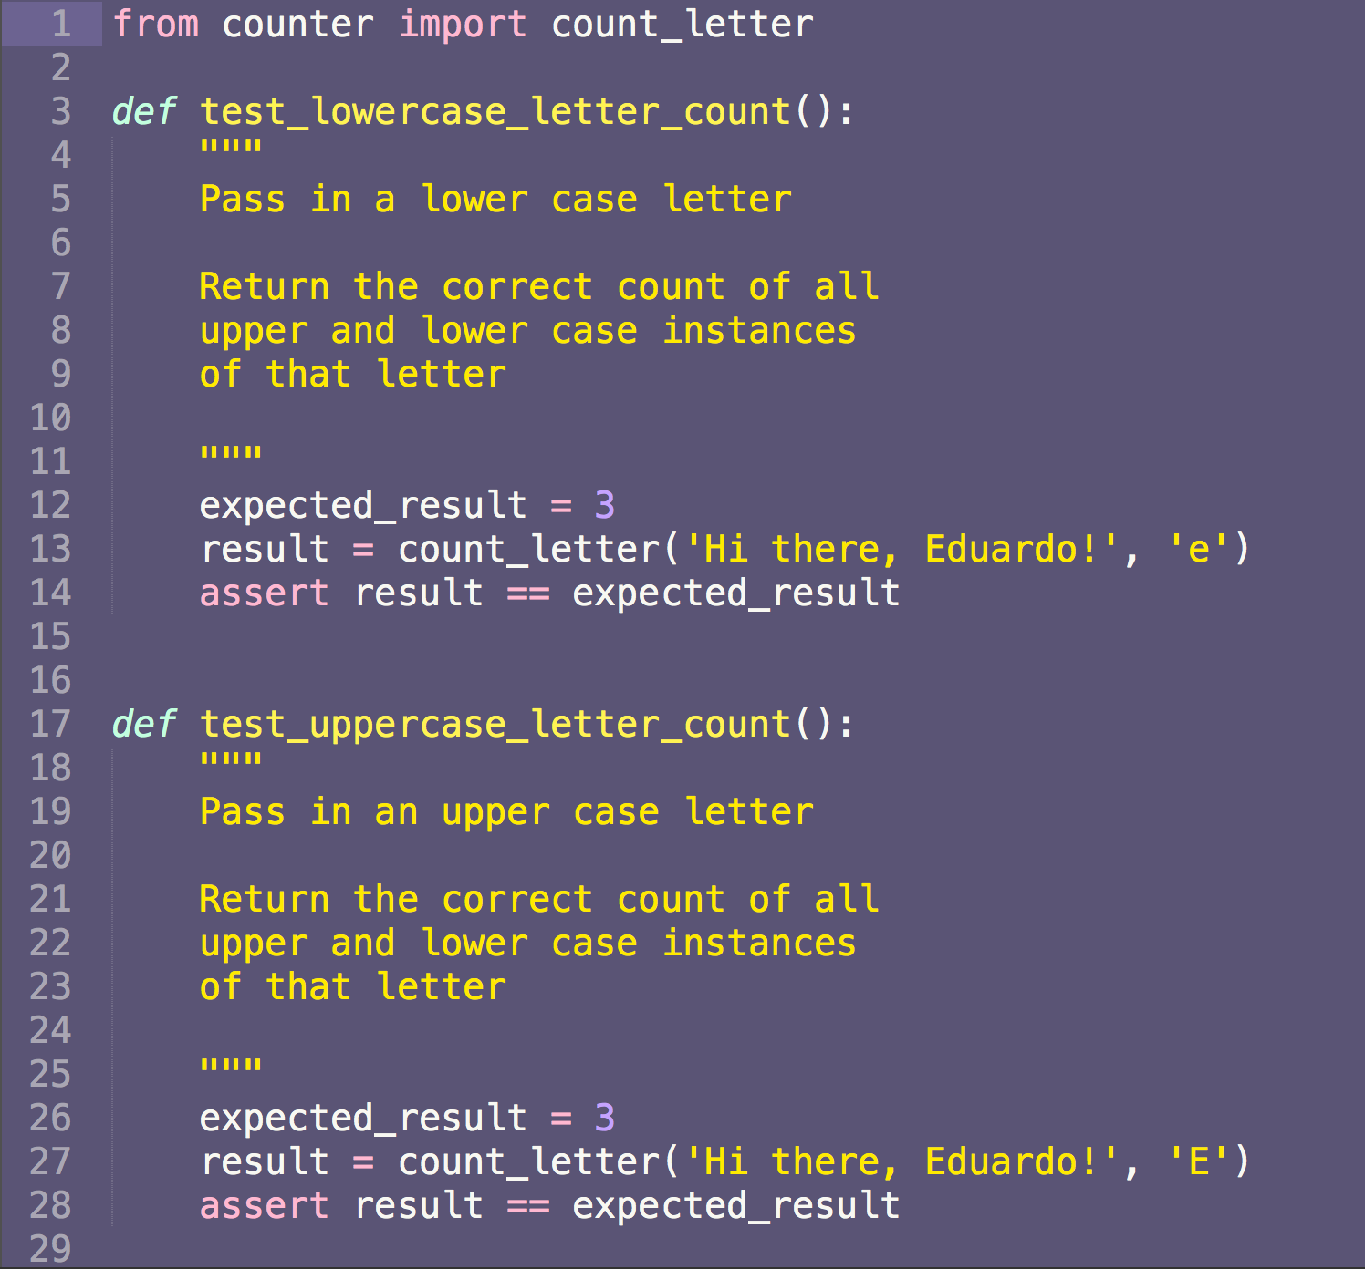
We know we ran into issues with lowercase vs. uppercase letters.
Let’s add a test to make sure we’re covered.
Step 1: Test and documentation!

Slide 21
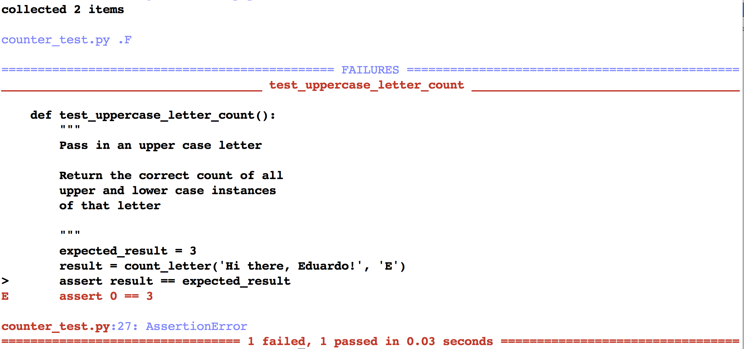
Step 2: Ensure test fails

Slide 22
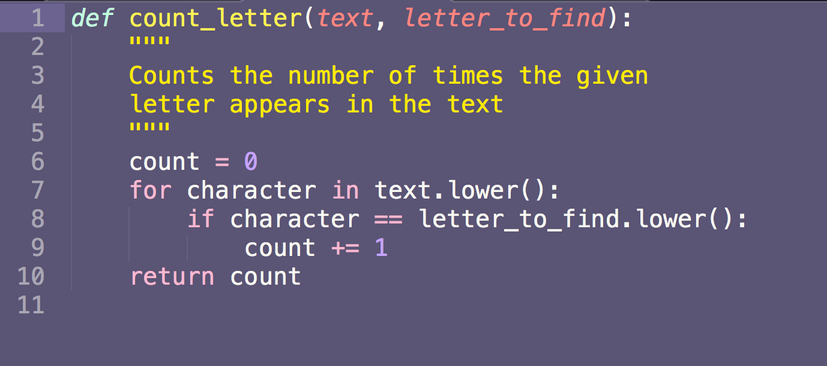
Step 3: Let’s add code that we think will fix things

Slide 23
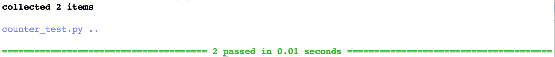
Step 4: Run tests and tests pass! Hooray!

Slide 24
But wait…
How do I know my tests aren’t buggy?

Slide 25
This is why we run tests before we write code!
A critical part of TDD is running the test before you’ve implemented the solution.
This helps us ensure that our tests aren’t giving us a false positive or negative.
If we get a positive test when we don’t have a solution yet, we know the test is wrong.

Slide 26
But doesn’t this take a lot longer?

Slide 27
Yes, but...it all depends.
Writing tests takes longer in the short term. But the return on the investment with tests happens when:
You can onboard new developers without fear that they’ll break anything
You’ll be able to add new features faster without fear of regressions
You’ll be able to refactor/rewrite code without fear of breaking a working system
Without test developer time is lost when:
Even the smallest of changes break features across the code base
Hunting down bugs
Trashing a code base because it can’t adapt

Slide 28
Testing & Refactoring
Testing isn’t only useful for bug fixing.
It can be difficult to remember why someone else or even yourself wrote something a certain way several months later.
Tests gives developers some trust that they can change an application and know they won’t break things in the process.

Slide 29
Let’s refactor :)

Slide 30
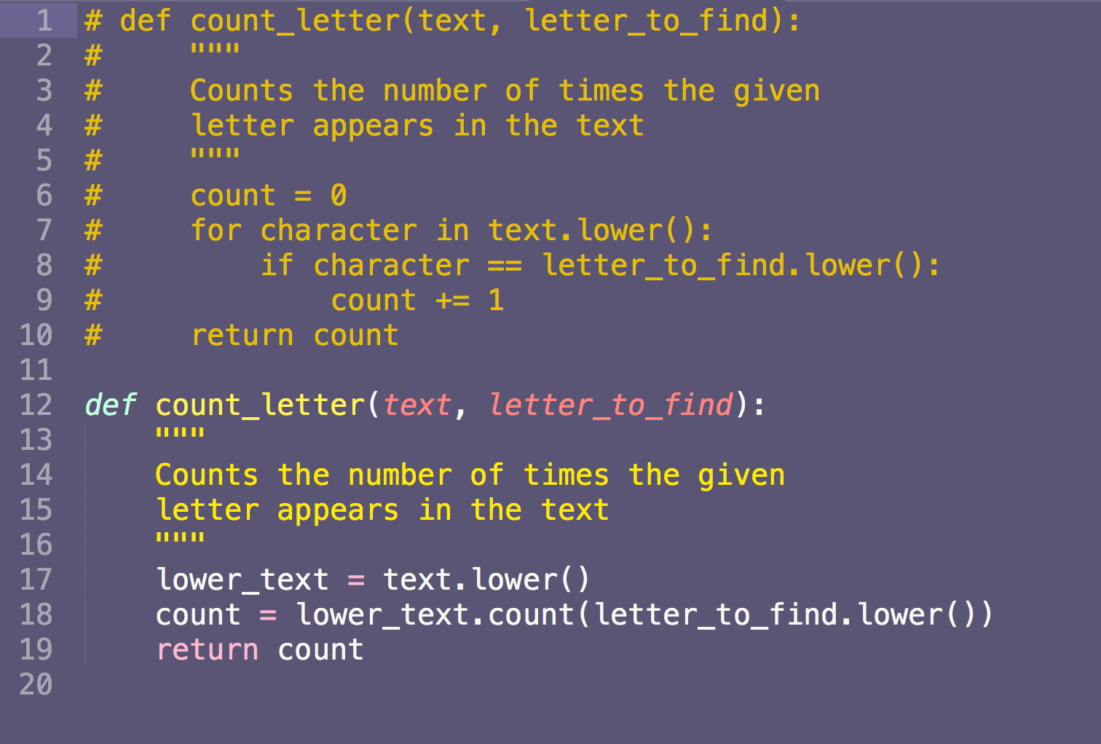

Slide 31
Tests pass! Hooray!

Slide 32
Summary of TDD
Write your test first.
Add the docstring with your requirements for the test.
Run your test (yes, even before you’ve written any code). Ensure it fails.
Fix the code.
Run the test again and ensure it passes.

Slide 33
Questions?

